Slide 1



Take a seat!
We’ll start at 7:05pm <3
DATA
Intro to Python + Data
Data Analysis w/ Numpy & Pandas

Slide 2


What are Packages?
Base Python: lets us use the basic functionalities from last workshop: creating variables, basic math, importing data
Packages are things we can install into Python to do new and cool things, similar to how you might add mods to a video game
base
python
python w/
packages

Slide 3


What are Packages?
There are two fundamental packages in Python that are used for Data Science/Analytics
Pandas: allows us to load data, examine it, and modify/clean it to fit our needs
NumPy (Numerical Python): allows us to store and work with numbers efficiently

Slide 4

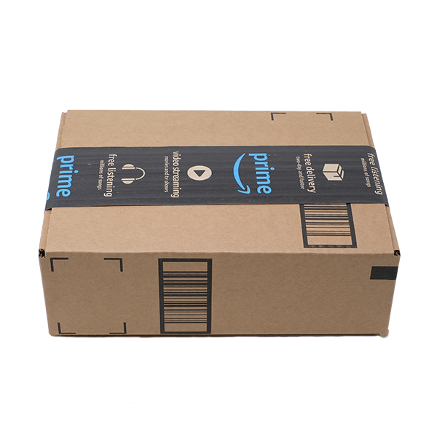

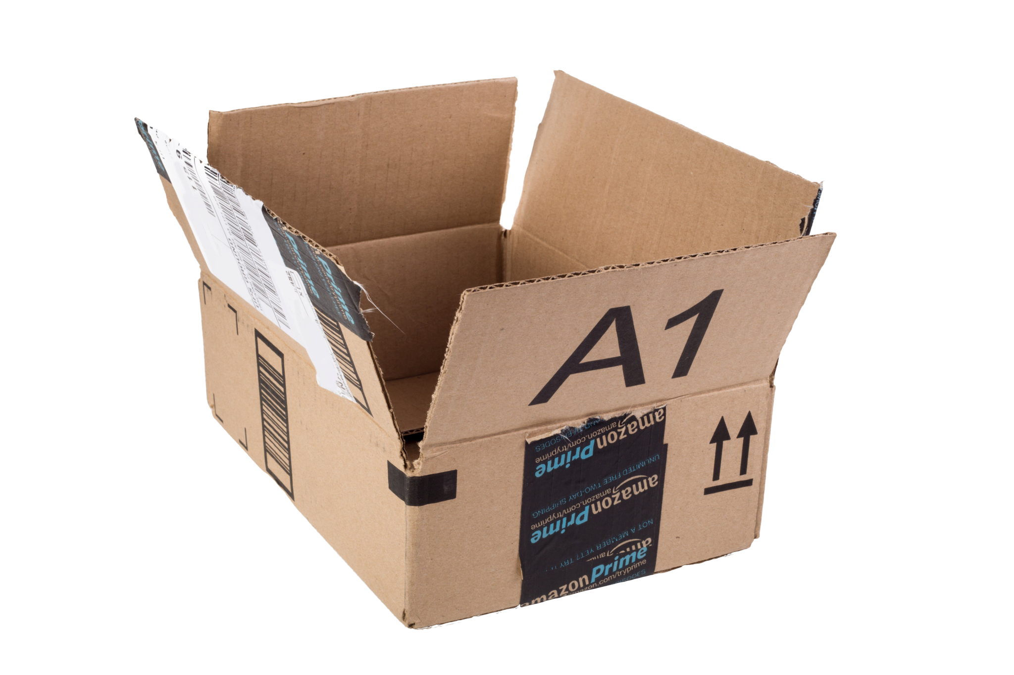
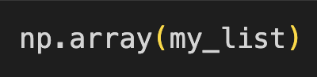
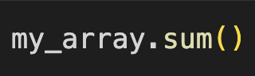
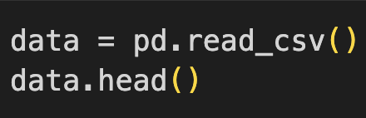
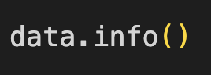

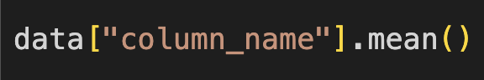
What are Packages?

Slide 5
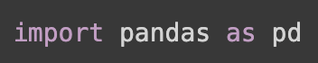
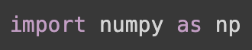
Installing Packages
We can install packages into our Python environment using the following conventions
Actual package name
Our nickname for it

Slide 6
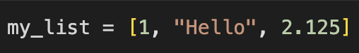
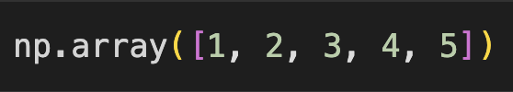
NumPy Data Types
Quick Review: Lists
A collection of items (can contain any data type)
NumPy Array
A collection of items with the same data type, most commonly numbers
We use Arrays instead of Lists for collections of numbers because it is faster, more memory efficient and easier to work with

Slide 7
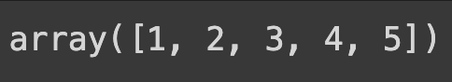
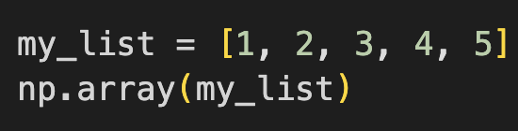
NumPy Data Types
A NumPy Array can be created by first making a List, then applying np.array()

Slide 8
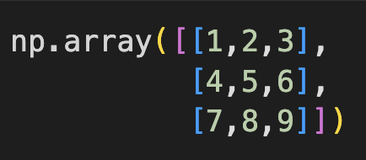
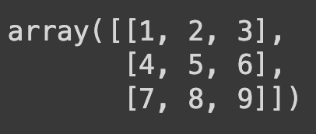
NumPy Data Types
An array made up of just one list is one dimensional
This example has 1 row and 5 columns, so it is a 1x5 array
We can make multi-dimensional arrays using more lists
This example has 3 rows and 3 columns, so it is a 3x3 array

Slide 9



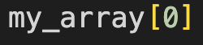

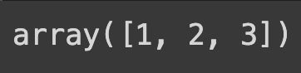
NumPy Data Types
We can also index arrays the same way as lists!
Remember that we start counting at 0!
0
1
2
3
4
We can retrieve multiple elements as well
Note: the last index is exclusive

Slide 10
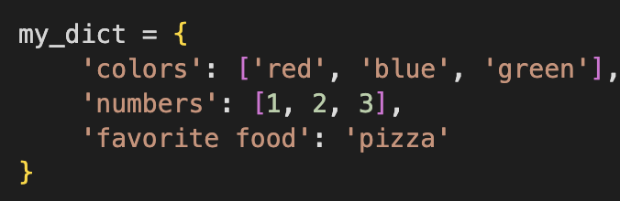

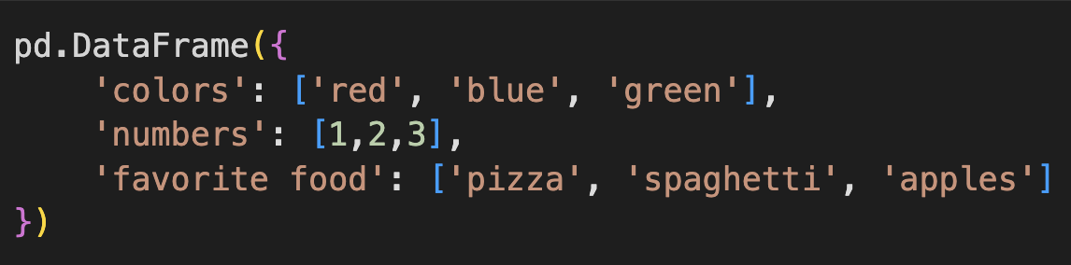
Pandas Data Types
Quick Review: Dictionaries
Collections of items organized to labels (called “keys”)
Pandas DataFrame
Very similar to a dictionary, but allows us to look at data as a table (each key/column must have the same number of values)

Slide 11
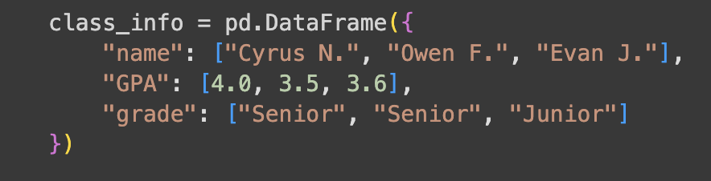
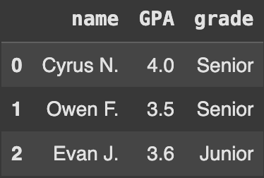
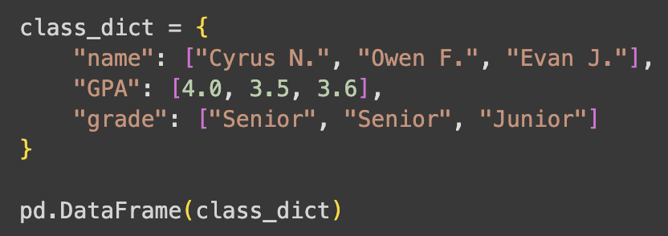
Pandas Data Types
Data frames allow us to make tidy data, where each row is an observation and each column is a feature/variable
Data frames are made by surrounding a dictionary with pd.DataFrame()

Slide 12
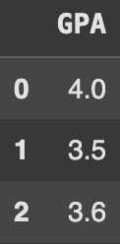
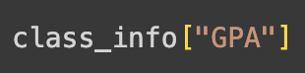
Pandas Data Types
Data frames allow us to index in two ways based on our needs
Retrieving a column:

Slide 13
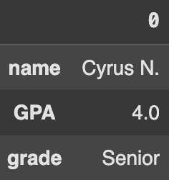
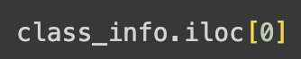
Pandas Data Types
Data frames allow us to index in two ways based on our needs
Retrieving a row:

Slide 14
Pandas Data Types
Pandas Series
A Data Frame with only one column, typically seen when we index a column
You may encounter errors or unexpected outcomes if you confuse these for Data Frames
Recall: you can use type() to check!

Slide 15
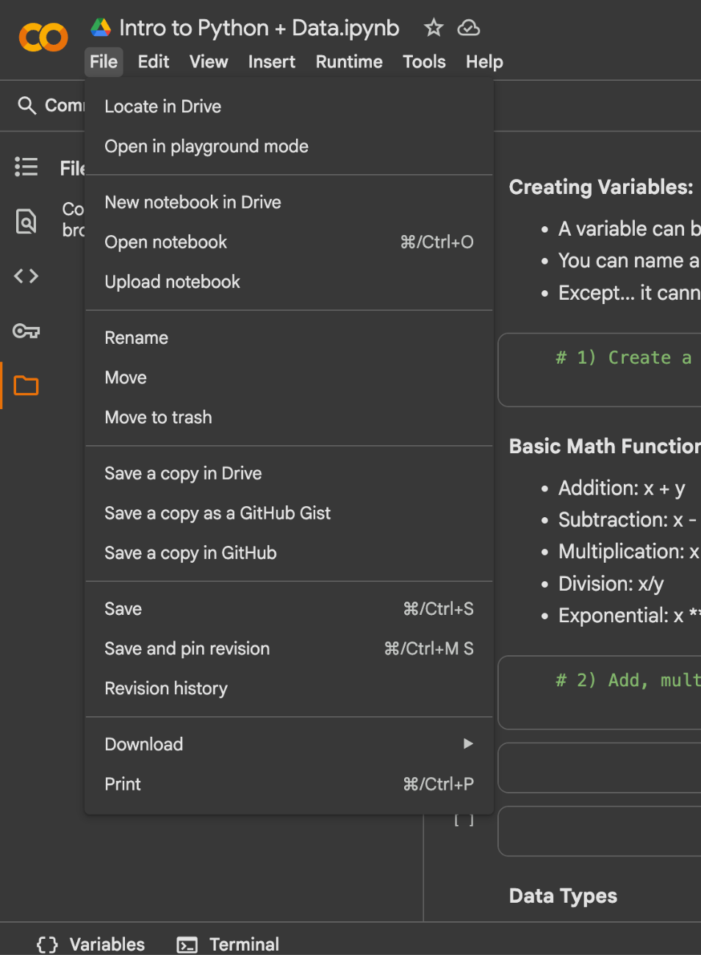
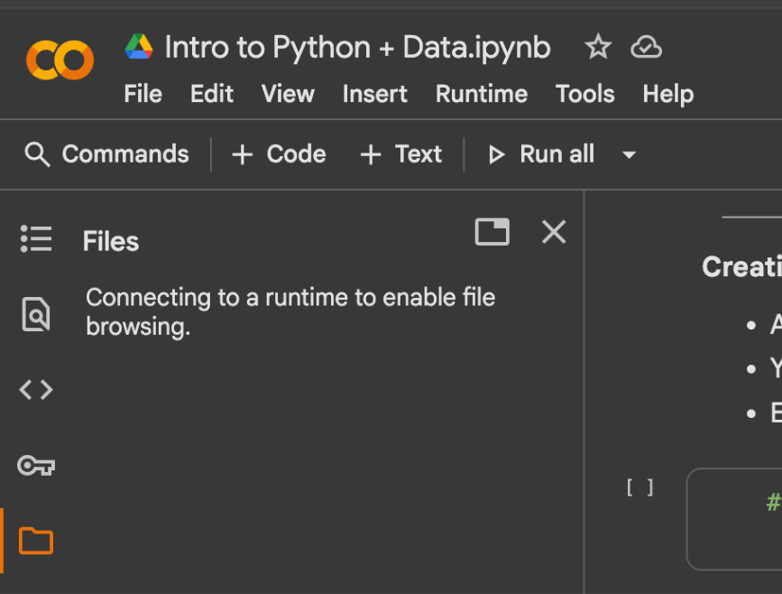
Your Turn!
Dataset: http://bit.ly/47kMlv0
Worksheet: http://bit.ly/4qljfVd

